Slide 1
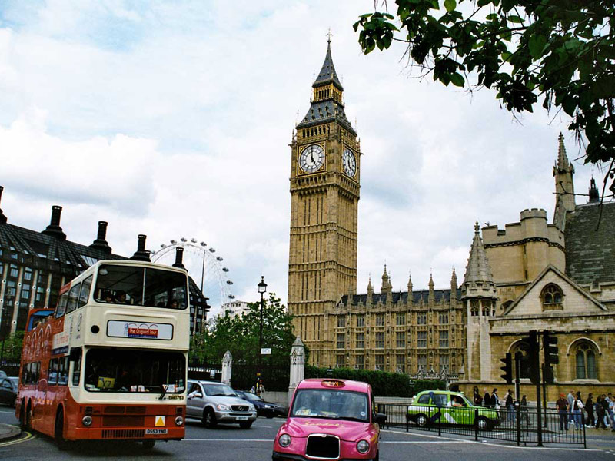
Sights of London

Slide 2
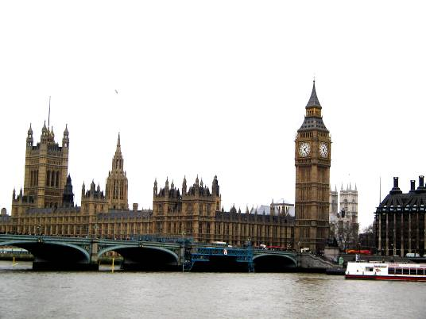
London is the capital of Great Britain.
It is one of the largest cities in the world.
London is situated on the river Thames.
The city is very old and beautiful.
It was founded more than two thousand years ago.

Slide 3
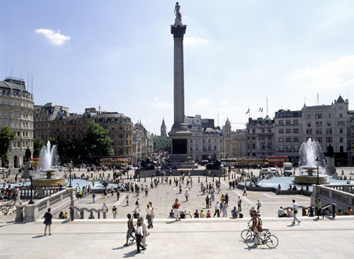
The centre of London is Trafalgar Square. In the middle of square stands a monument to Admiral Nelson.

Slide 4
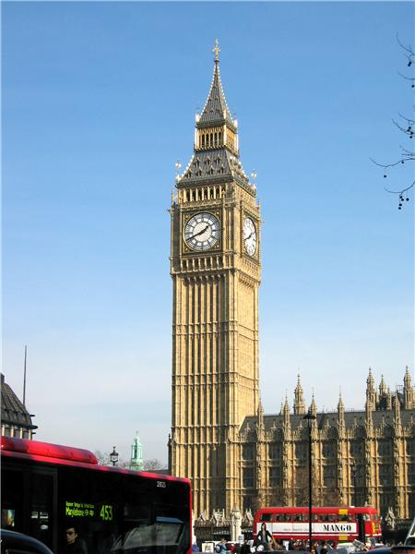
The large clock in one of the towers is Big Ben.
You can hear the sound of Big Ben every hour in London.

Slide 5
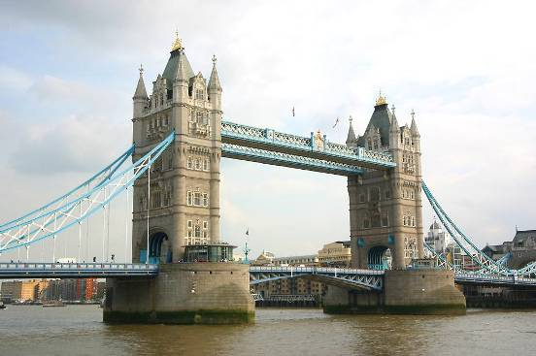
Tower Bridge is the oldest and famous bridge
across the Thames.

Slide 6
The Houses of Parliament is a place where the British Government sits.

Slide 7
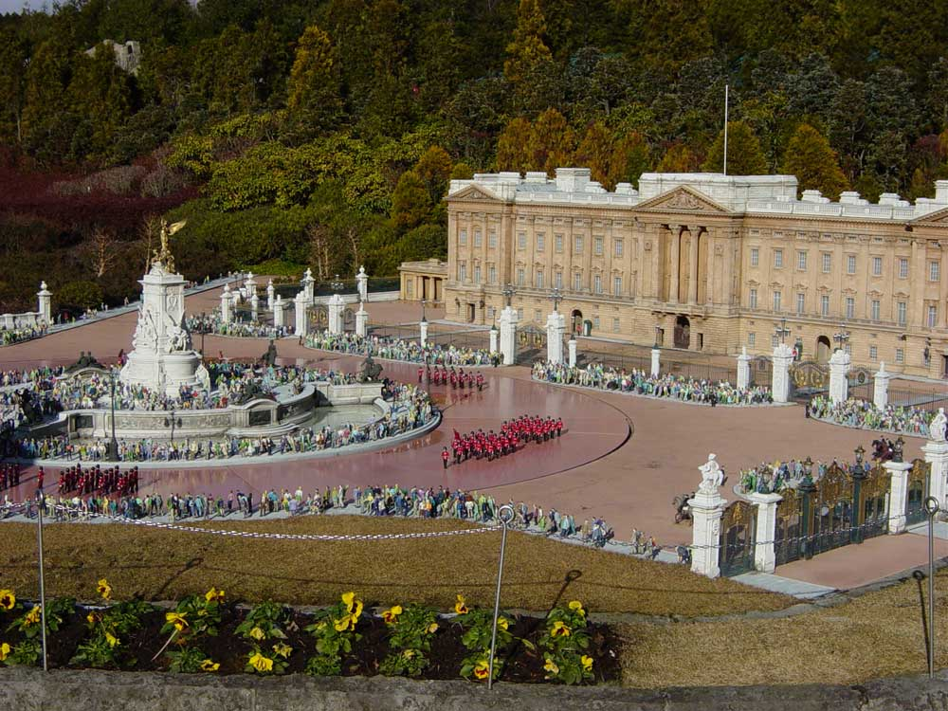
The Queen of England lives in Buckingham Palace.
It is a wonderful building.

Slide 8
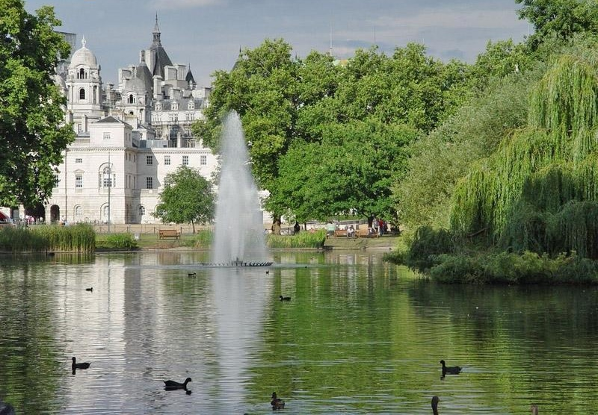
St. James’s Park is the oldest park.
There are many trees, grass, flowers and water.

Slide 9
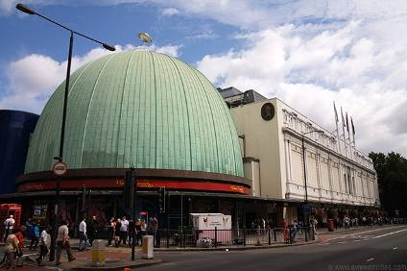
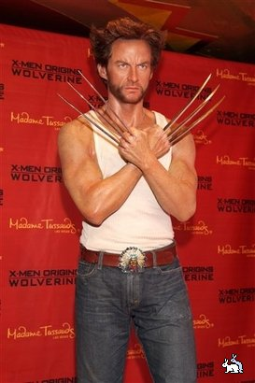
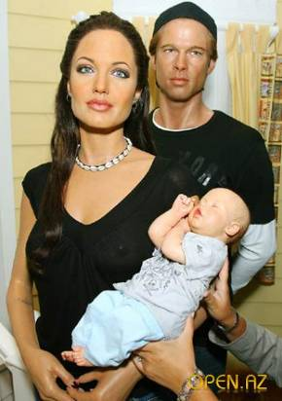
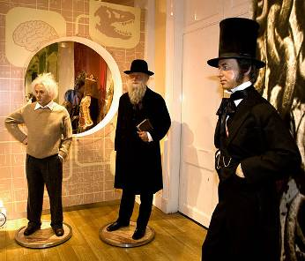
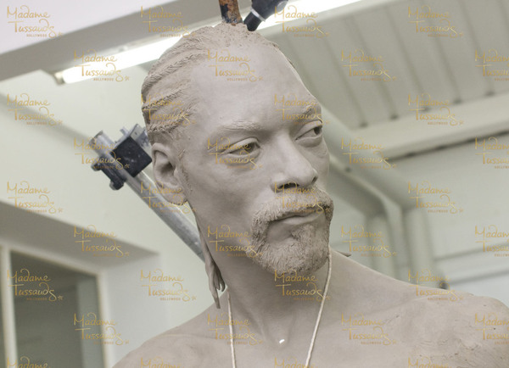
Madame Tussaud’s is a famous museum of wax figures.
They have wax figures of all the famous people in the world.

Slide 10
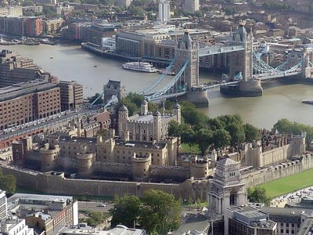
Thank for your attention!

